Slide 1

Critical Perspectives on Depressive Disorders Lecture 4
PSY3011S
Siyabulela Mkabile
s.mkabile@uct.ac.za

Slide 2
Discrimination based on Sexual Orientation
Pre-1996 - homosexuality was illegal in apartheid South Africa and several laws denied gay men and lesbian women legal recourse for victimisation
2006 - the South African Constitutional Court affirmed the right to same sex marriage. However, discrimination based on sexual orientation still exists.
Living in a heterosexist and homophobic society results in a significant amount of stress and increases the risk of developing psychological disorders
(Polders et al., 2008)

Slide 3
Discrimination based on Sexual Orientation
South African research into the aetiology of depression among individuals who self-identify as gay or lesbian is limited
International studies suggest a higher prevalence rates of mood, anxiety and substance use disorders and suicidality
Barriers to help seeking: limited specialist services; discrimination in the health care system; lack of professional education and training negatively affects the health-care patient provider relationship
(Lee et al. 2016; Polders et al., 2008)

Slide 4
Discrimination based on Sexual Orientation
Risk factors
Social support and level of disclosure of sexual orientation
Frequency of the experience of hate speech
Experiencing physical victimisation and fear of victimisation
Self-acceptance of sexual identity
Internalised stigma
Family acceptance of sexual identity
Social cohesion and belonging
Self-esteem
(Lee et al. 2016; Polders et al., 2008)

Slide 5
Cultural Variations in Depression
“Culture refers to systems of knowledge, concepts, rules, and practices that are learned and transmitted across generations. Culture includes language, religion and spirituality, family structures, life-cycle stages, ceremonial rituals, and customs, as well as moral and legal systems. Cultures are open, dynamic systems that undergo continuous change over time; in the contemporary world, most individuals and groups are exposed to multiple cultures, which they use to fashion their own identities and make sense of experience” (APA, 2013).

Slide 6
Cultural Variations in Depression
Need to question the DSM’s assumption of universality
Cross-national epidemiological research has found that depression occurs worldwide. However, there are cultural variations in:
Types of symptoms exhibited
Expression of symptoms
Interpretation of symptoms
Help-seeking behaviours

Slide 7
Cultural Variations in Depression
Somatisation
Belief that Non-Western patients somatise their distress (flawed, sweeping generalisation)
Musculoskeletal pain and fatigue are the most common bodily idioms of distress
Other reported bodily idioms of distress include weakness, headaches, heart and chest pain, abdominal distress constriction of the head and numbness in the limbs

Slide 8
Cultural Variations in Depression
Somatization
Haiti – references to the heart and the head; constricted heart; loaded head; spinning head; thinking too much; feeling like you are ‘going down’; lost the taste for doing anything; difficulty sleeping; low energy (Rasmussen et al. 2015)
China – headache; heart palpitations; pressure in the chest; numbness in the limbs; bodily aches and pains; feeling sad; loss of self-confidence; hard to enjoy things (Ryder et al. 2008)

Slide 9
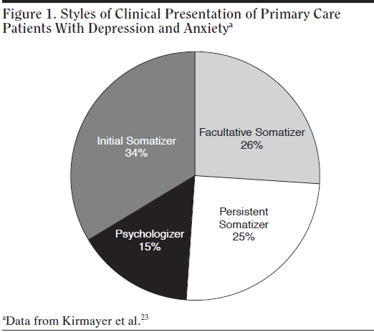
Somatic presentation of 700 Canadian patients attending family medicine clinics
(Kirmayer, 2001)

Slide 10
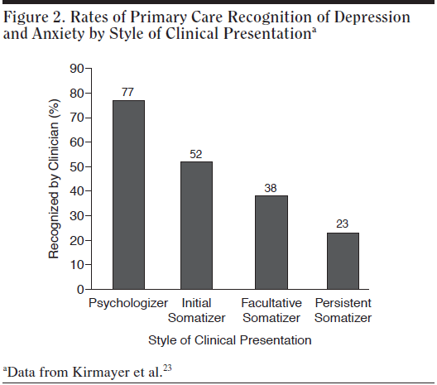
(Kirmayer, 2001)

Slide 11
Cultural Variations in Depression
It is important for clinicians to:
Move away from the stereotypical Western vs. Non-Western dichotomy
Consider the dynamics of hybrid identities
Move beyond focusing on psychiatric nosology
Use a patient-centred approach
Adopt an open, interested and respectful attitude towards the client
Take the time to understand client's point of view

